Slide 1
VTK-python programming codes

Slide 2
mat_loadsave
Run loadmat_test1.py
Source data path is hard-coded.
Matlab .mat file input & output test using scipy package
Read vel_struct.mat
Access contents
Modify and save in .mat format
save1: save as is
save2: modify using python array
save3: modify using numpy array

Slide 3
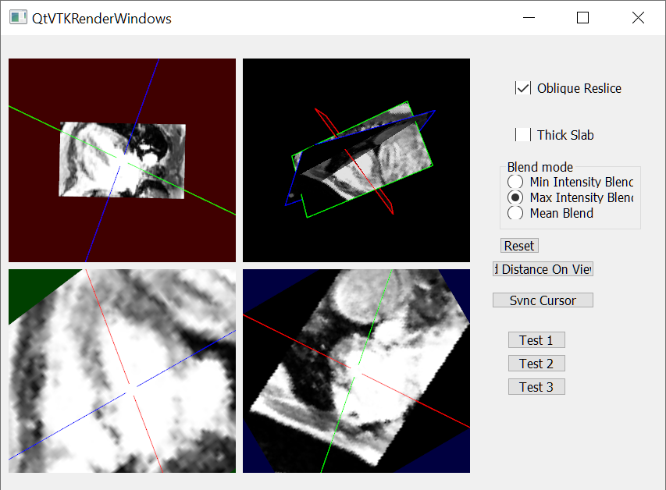
FourPaneViewer
Run QtVTKRenderWindows.py
Based on VTK C++ example
Converted to python
Source data path is hard-coded.
Function
Read mag struct in mrStruct
Display in three 2D reslice view and combined view in 3D space
2D reslice view is adjusted by moving axis line.
Angle between axes is not retained.

Slide 4
temporal_processing-200714-1_planeCrossAnalysis
Run ParticleTracingTest.py
Source data path is hard-coded.
s.SetFilepathMagnitude
s.SetFilepathVelocity
s.SetFilepathMask
Plane definition is hard-coded.
planeSourceMV
planeSourceAV
Function
Read mrstruct magnitude, velocity, and mask
Particle Tracing starting from Mitral valve
Pathline Visualization
Sort out each pathline segment cross
Inside AV
Across AV
Outside AV

Slide 5
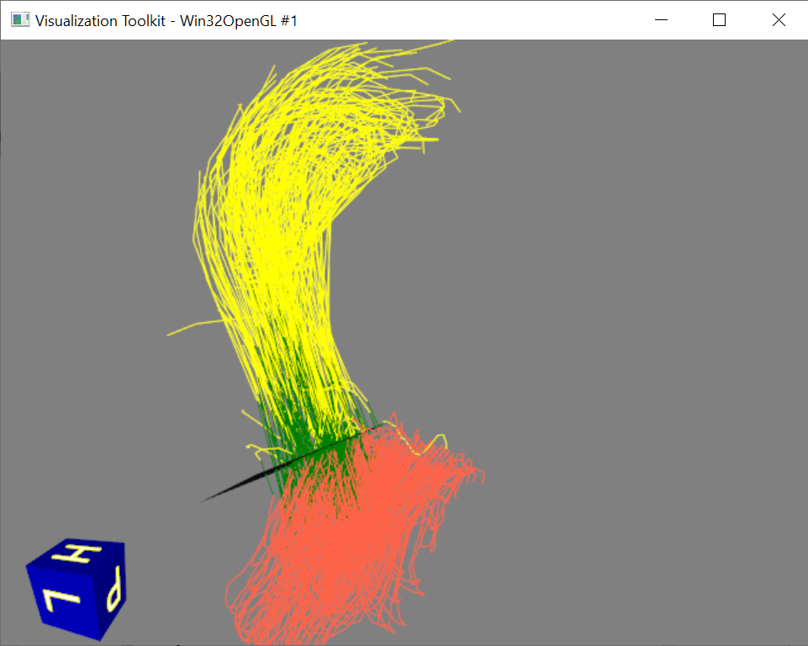
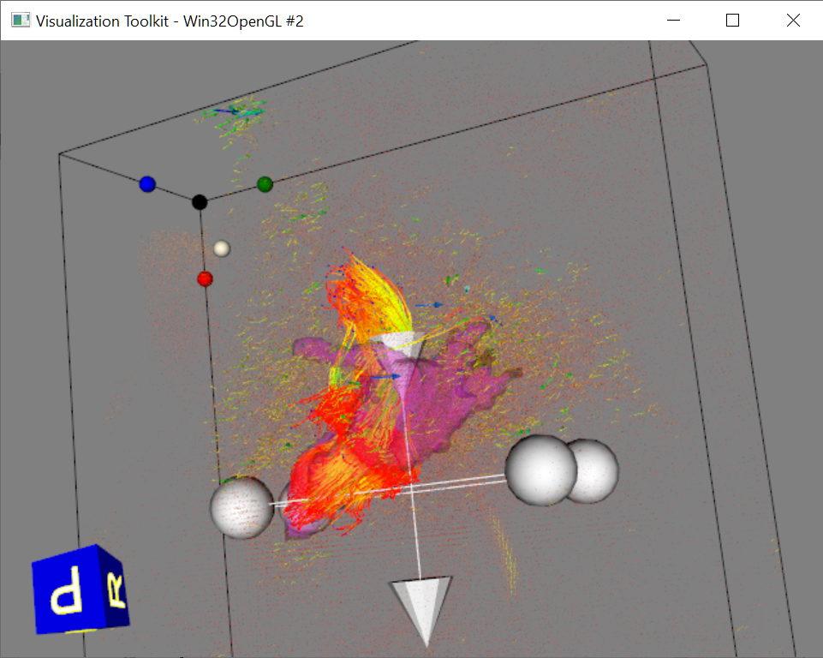
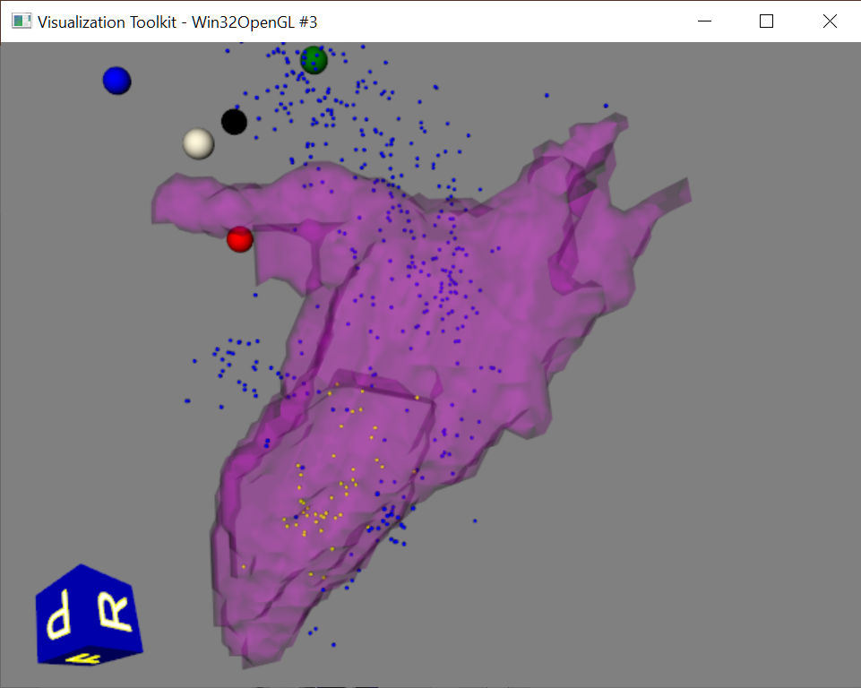
temporal_processing-200714-1_planeCrossAnalysis
Tomato: Pathline segment Inside AV
Green: Pathline segment Across AV
Yellow: Pathline segment Outside AV
Pathline visualization with LA mask and velocity vectors
Particle location after completing tracing for a heart cycle.

Slide 6
temporal_processing
Under development version
Goal: repeat tracing retained inflow from where it ends
Particle source is defined by a group of points (PolyPointSource) rather than plane
Valve flow quantification – for automatic detect of IVR
Refactoring, restructuring
Not fully work
Run ParticleTracingTest.py
Source data path is hard-coded.
filepathMagnitude, filepathVelocity
Plane definition is hard-coded.
pointsPlaneMV, pointsPlaneAV
Function
Read mrstruct mag&vel&mask
Visualize LA volume
Visualize PC-MRA volume with velocity vector
Particle tracing

Slide 7
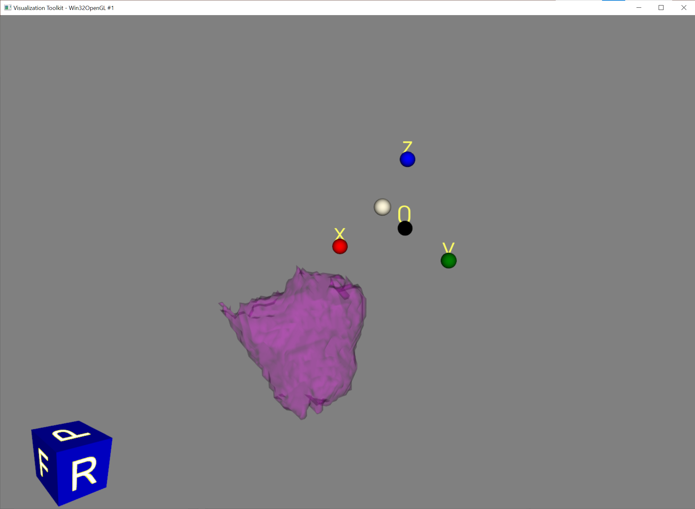
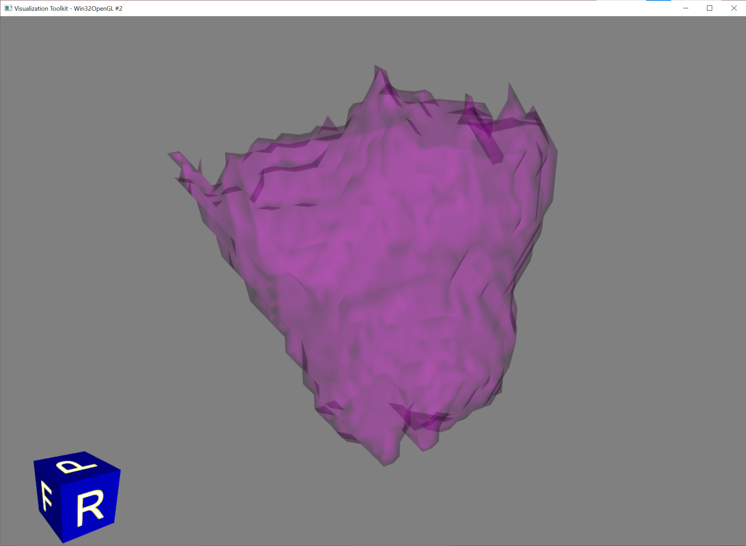
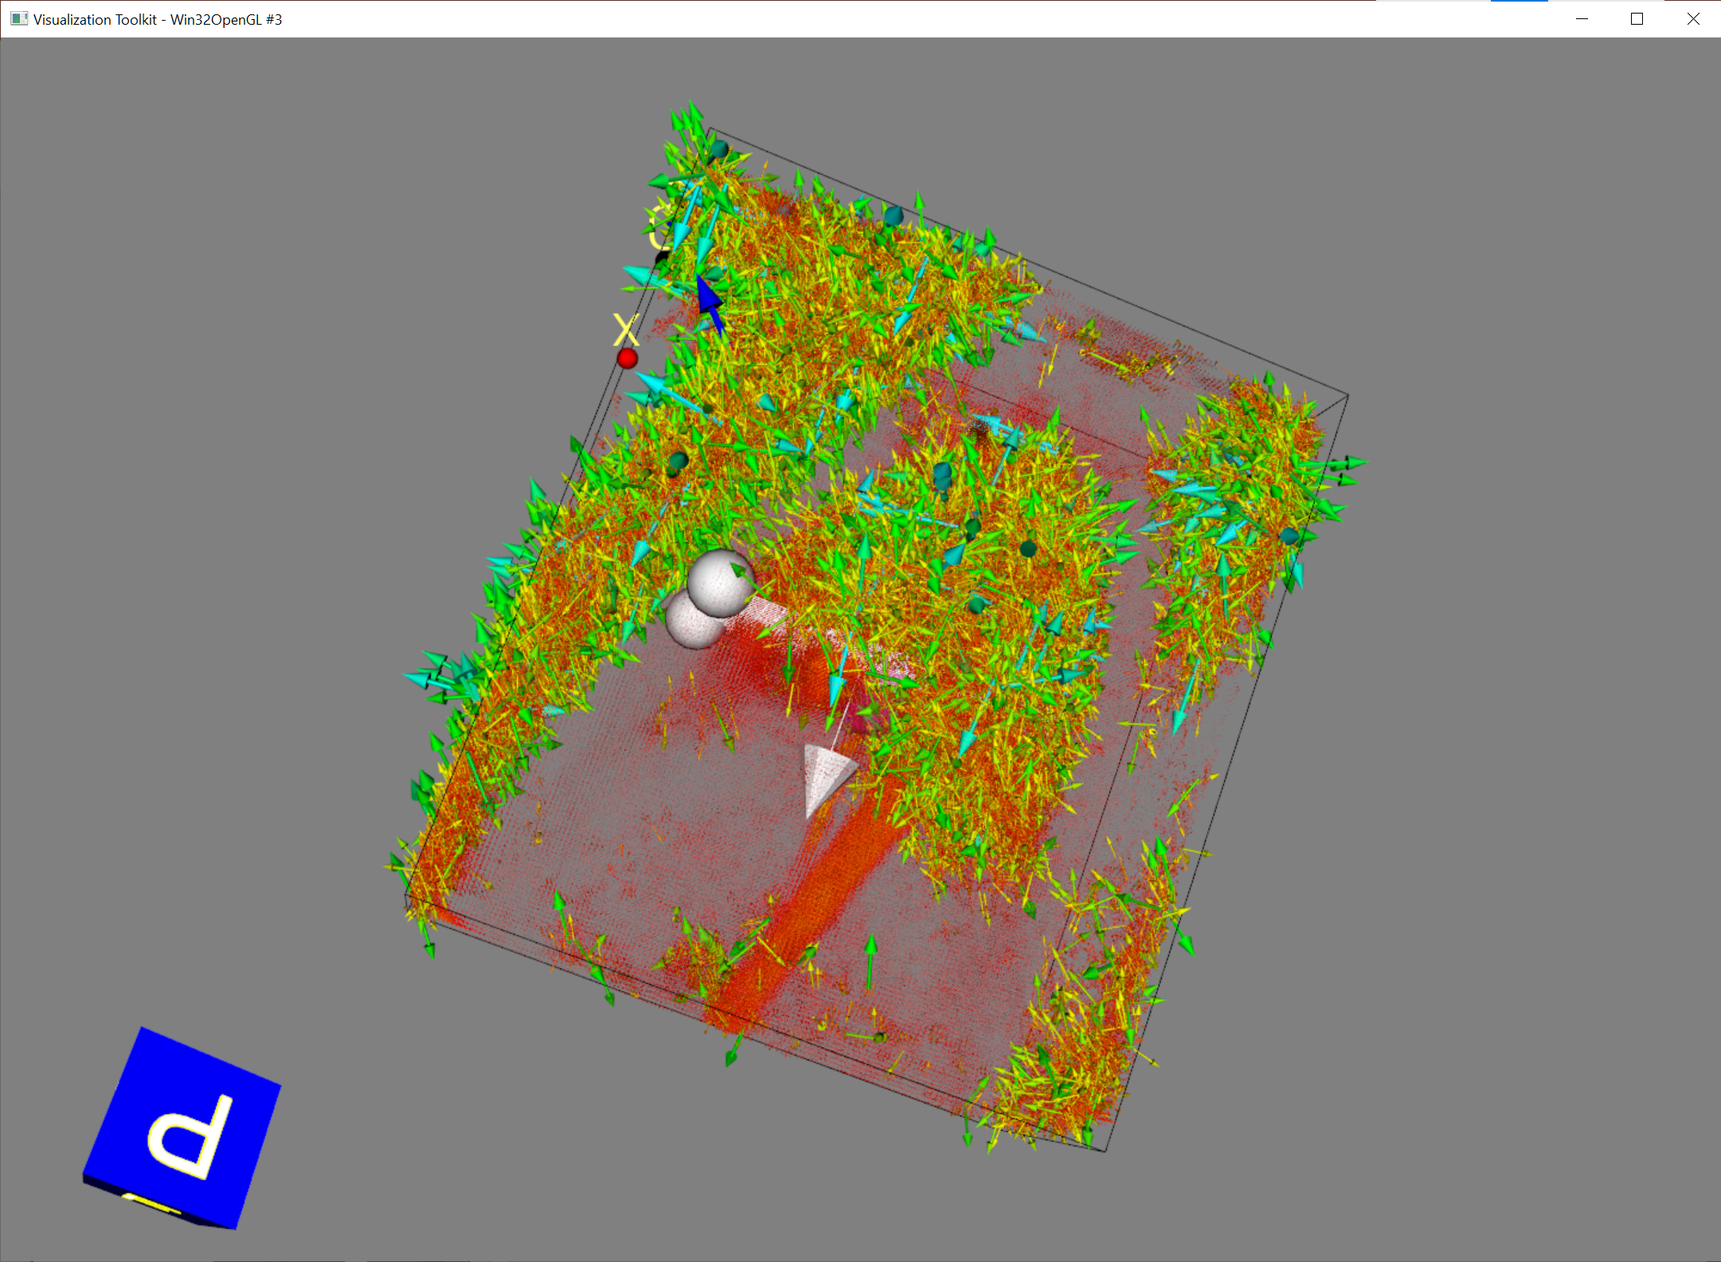
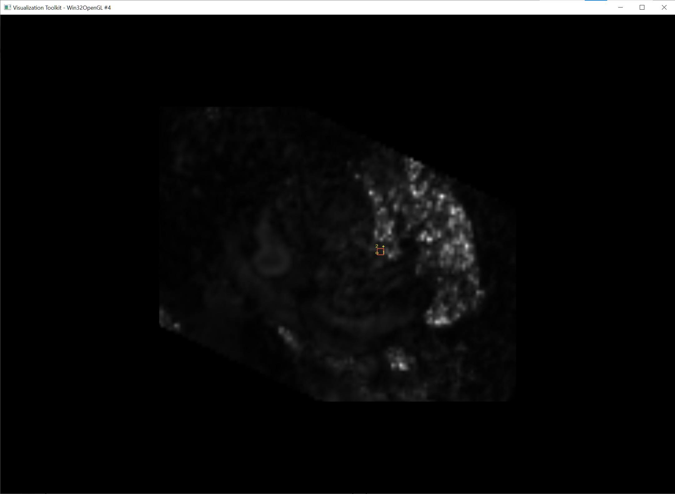
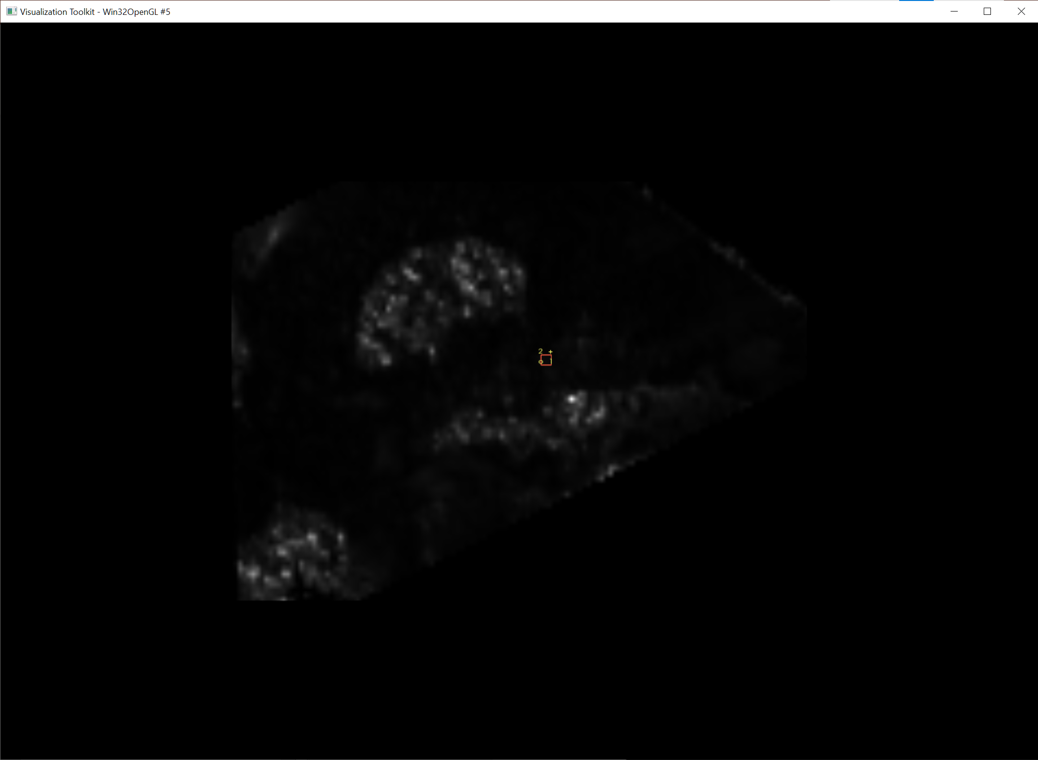
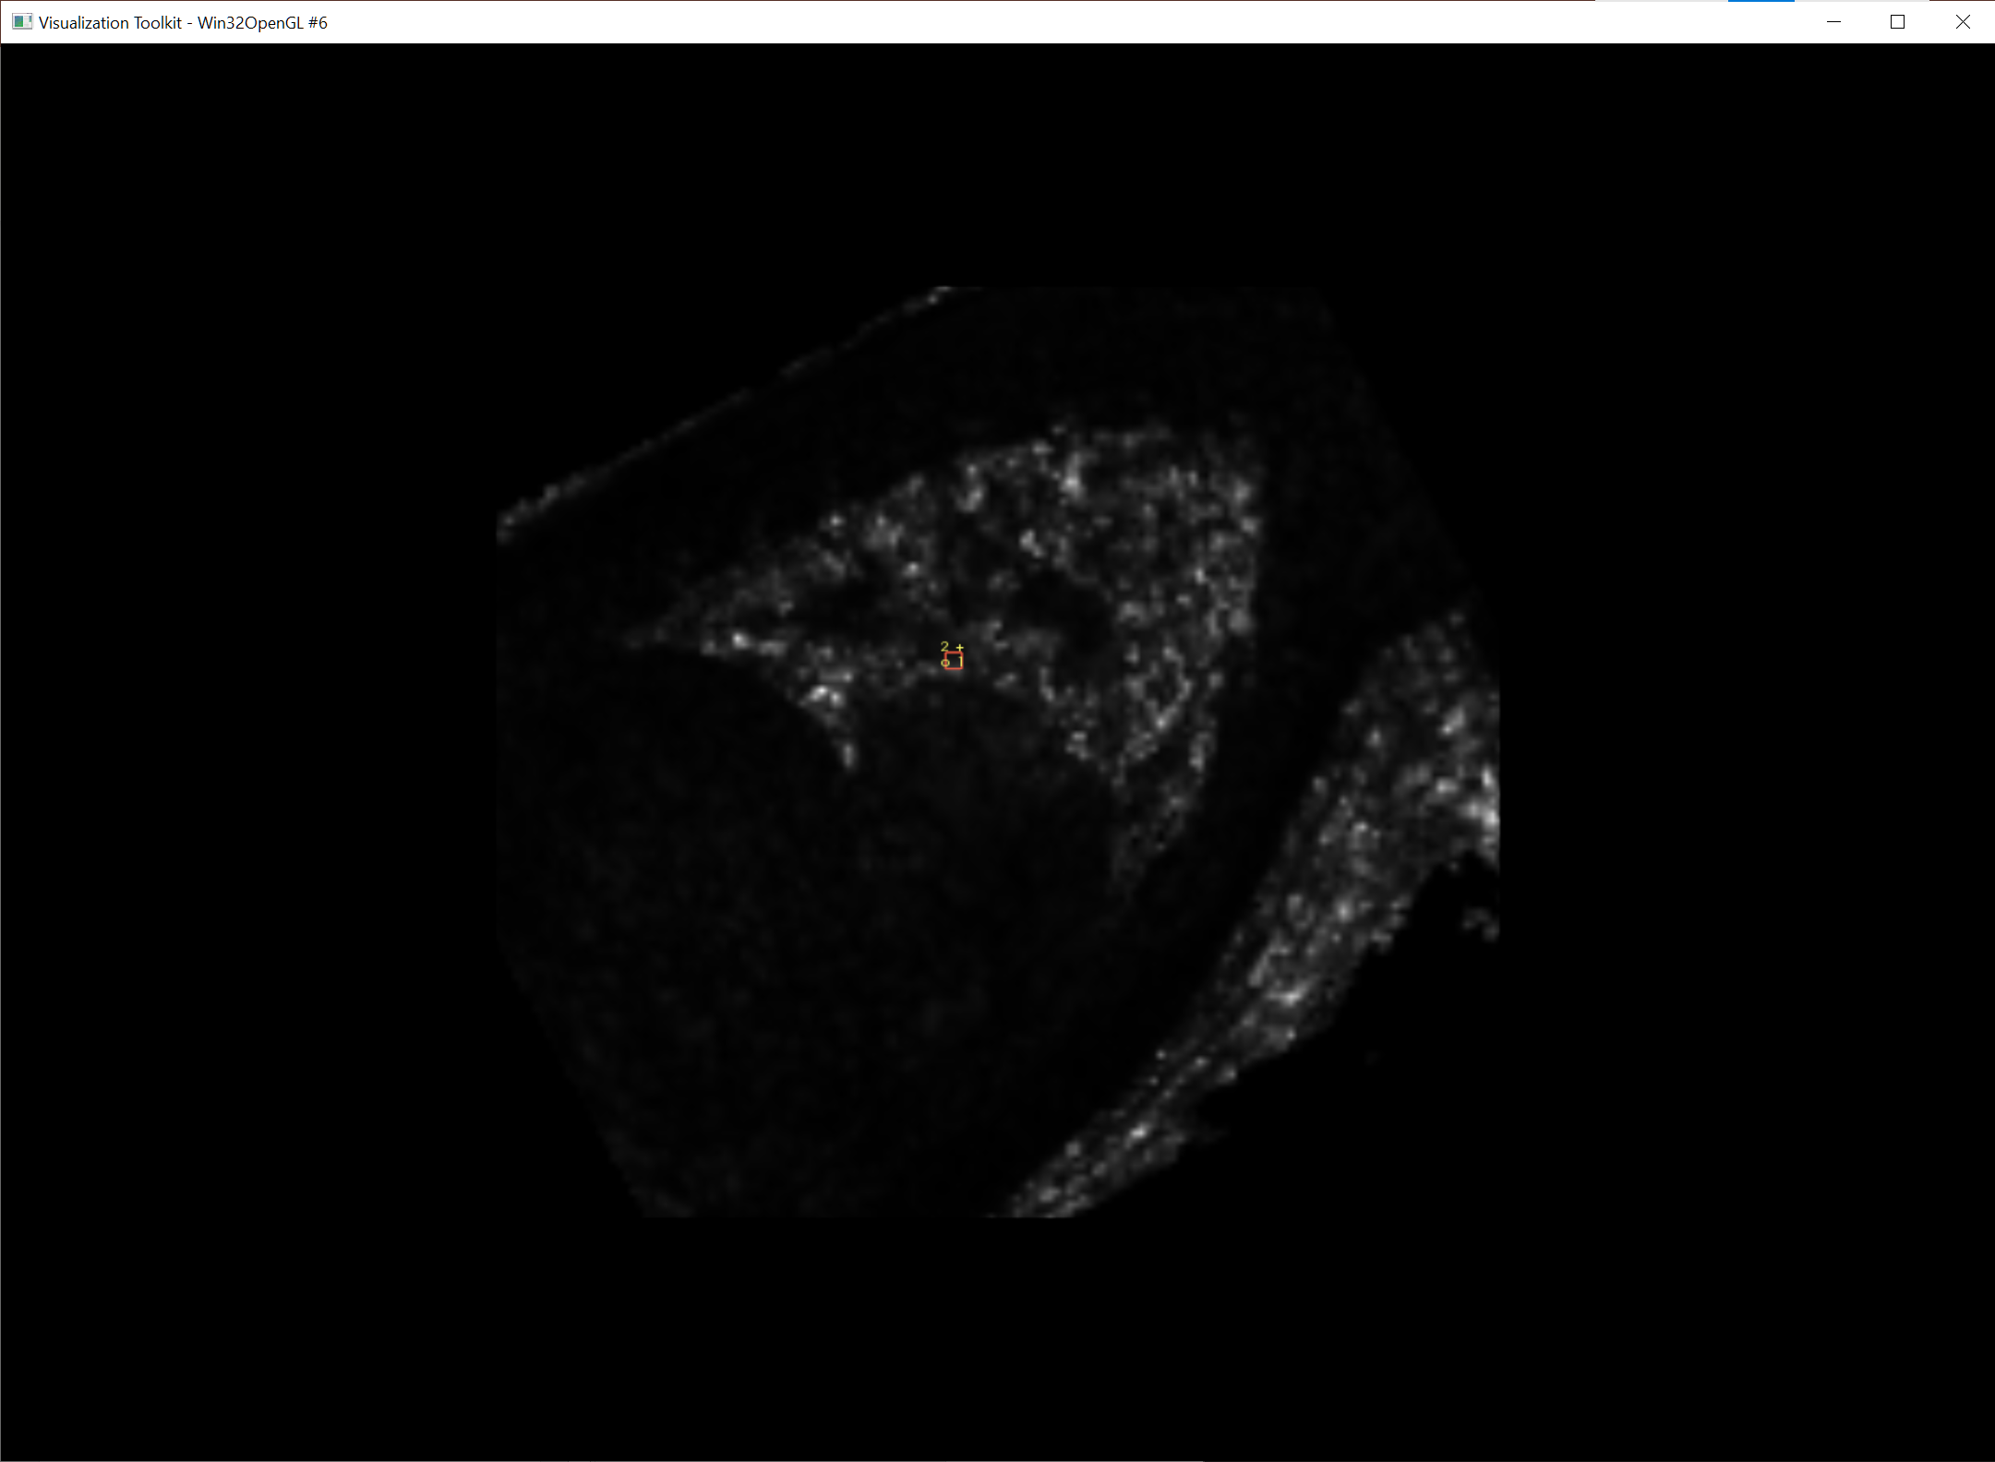
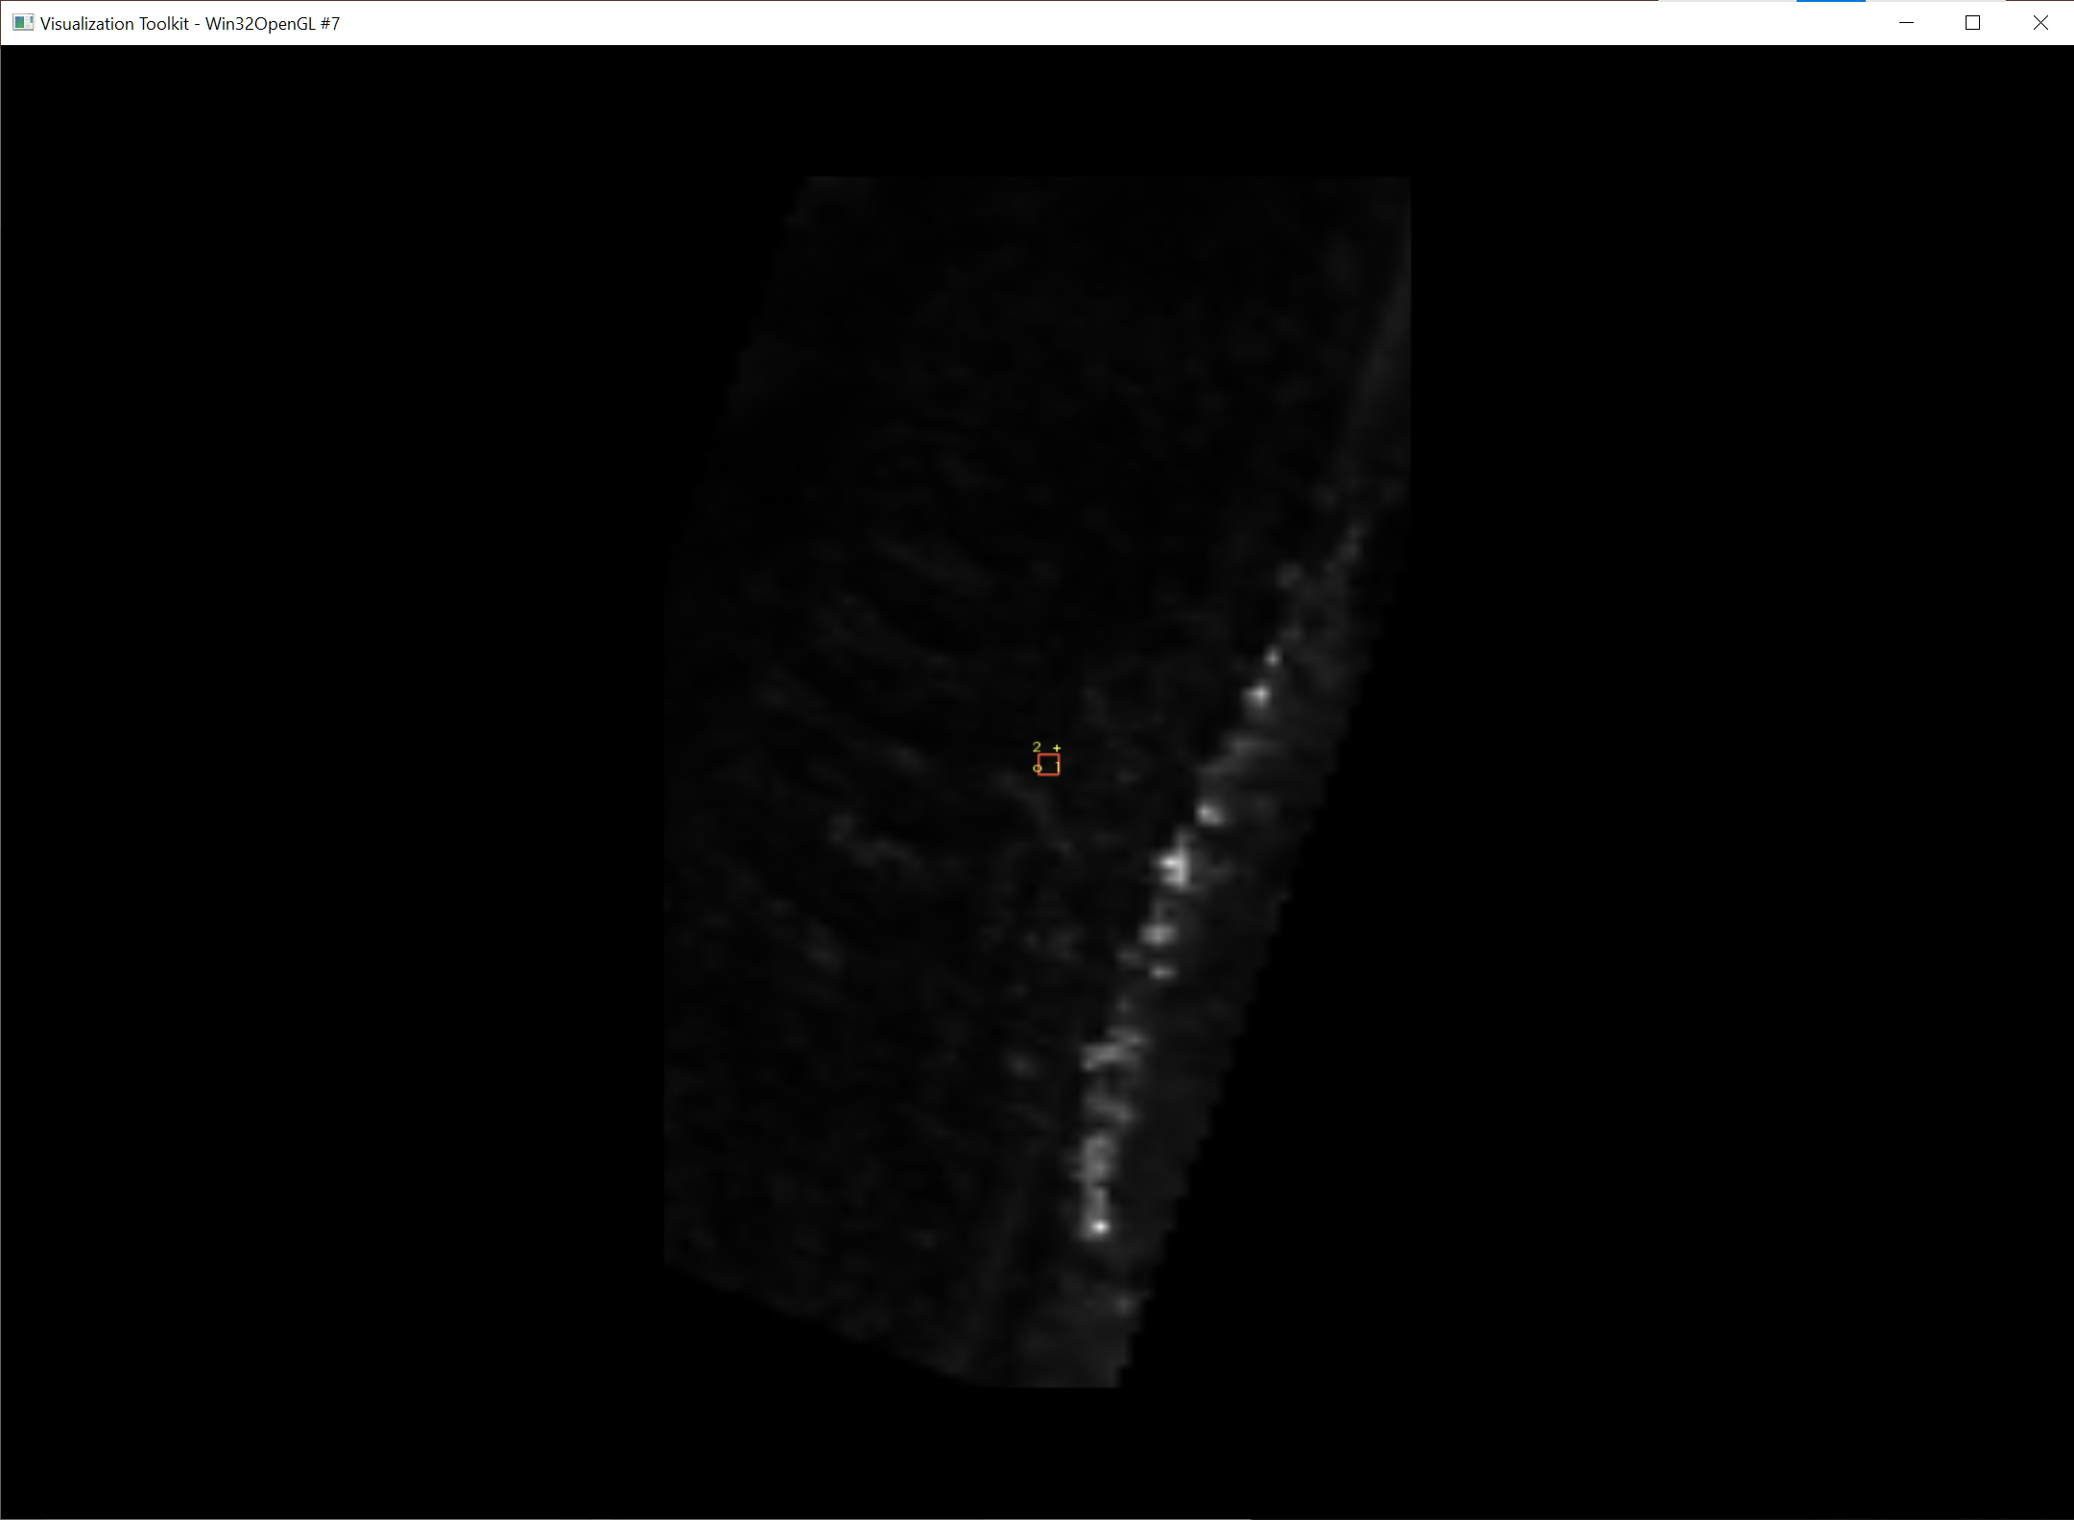
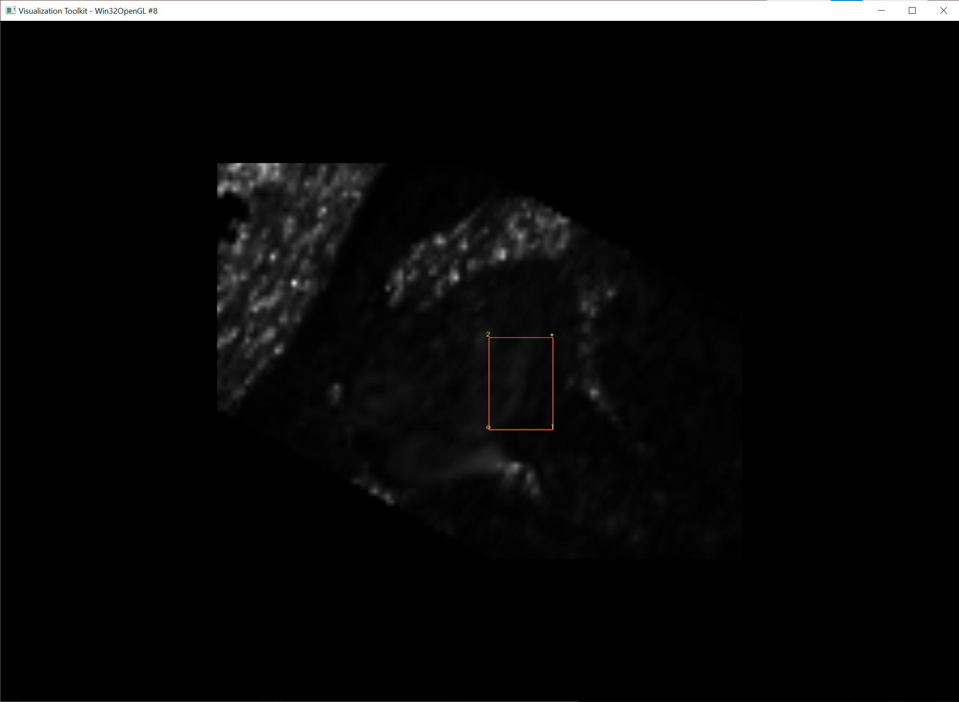
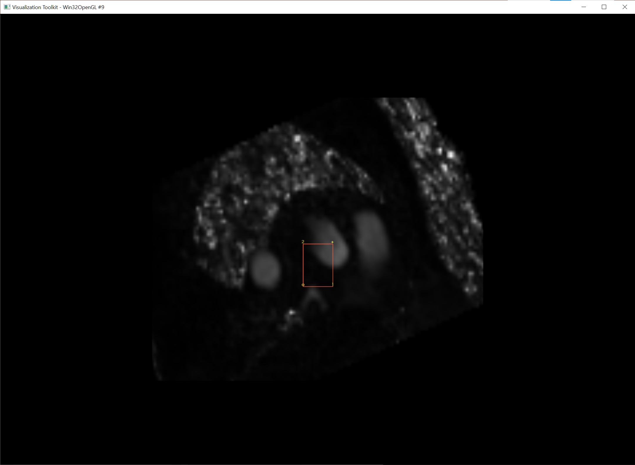
temporal_processing
Visualize LA volume
Visualize PC-MRA volume with velocity vector
Confirm MV plane definition
Confirm AV plane definition

Slide 8
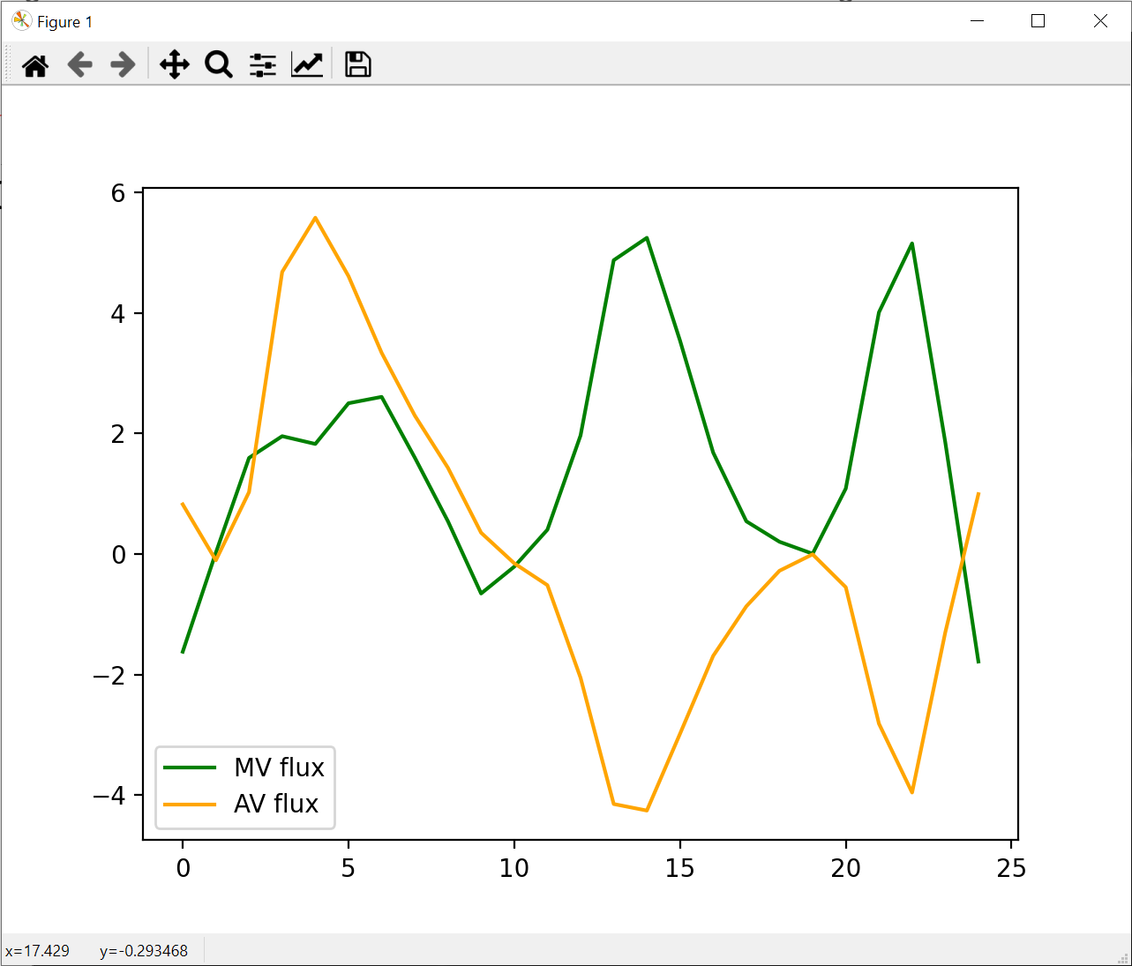
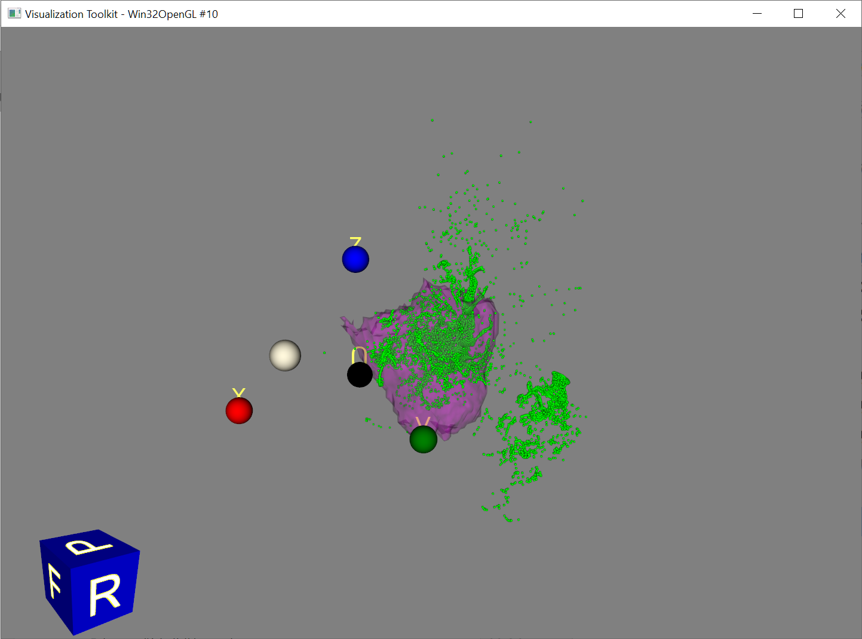
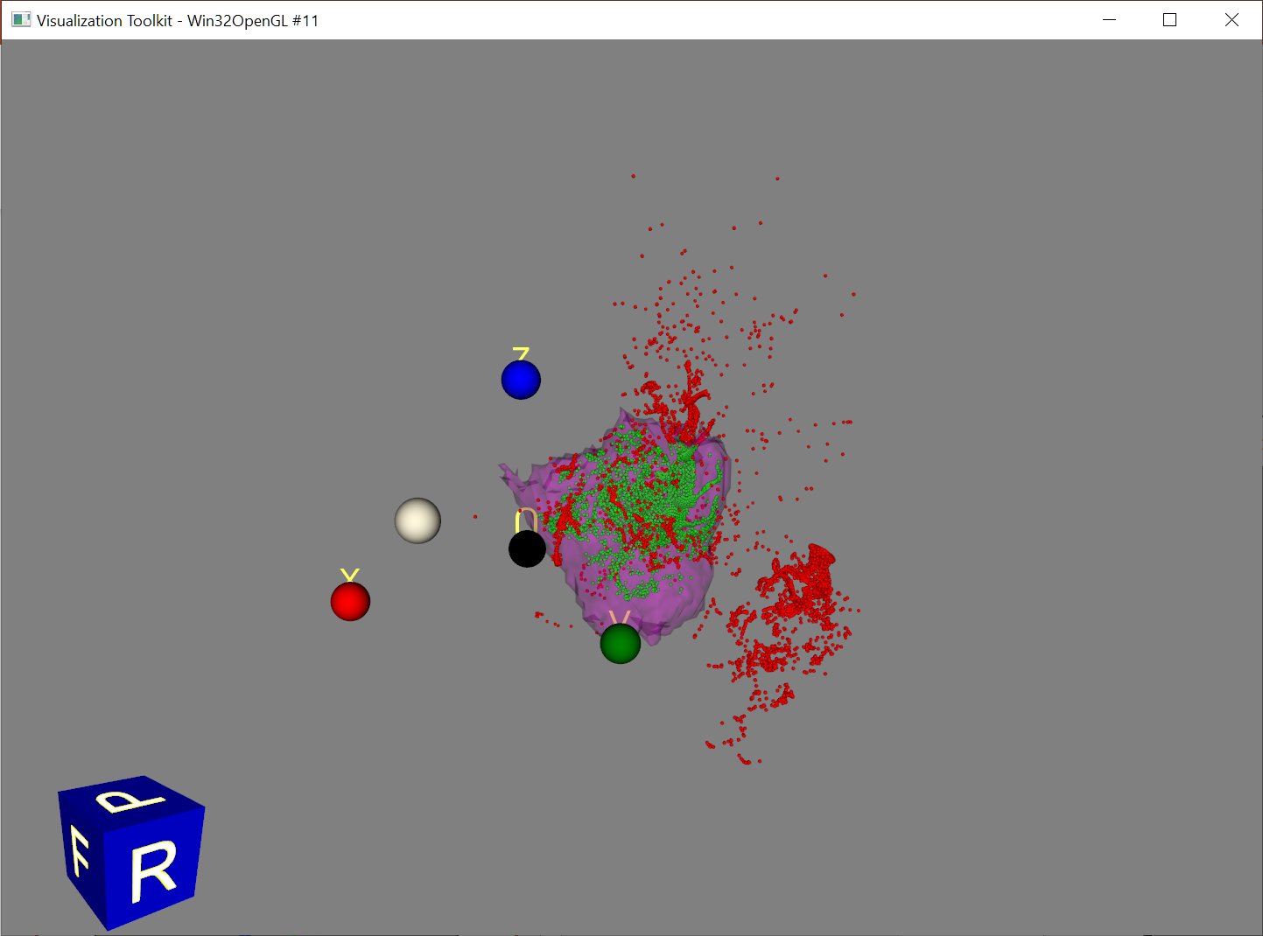
temporal_processing
Check flow through MV & AV
Particle locations after particle tracing

Slide 9
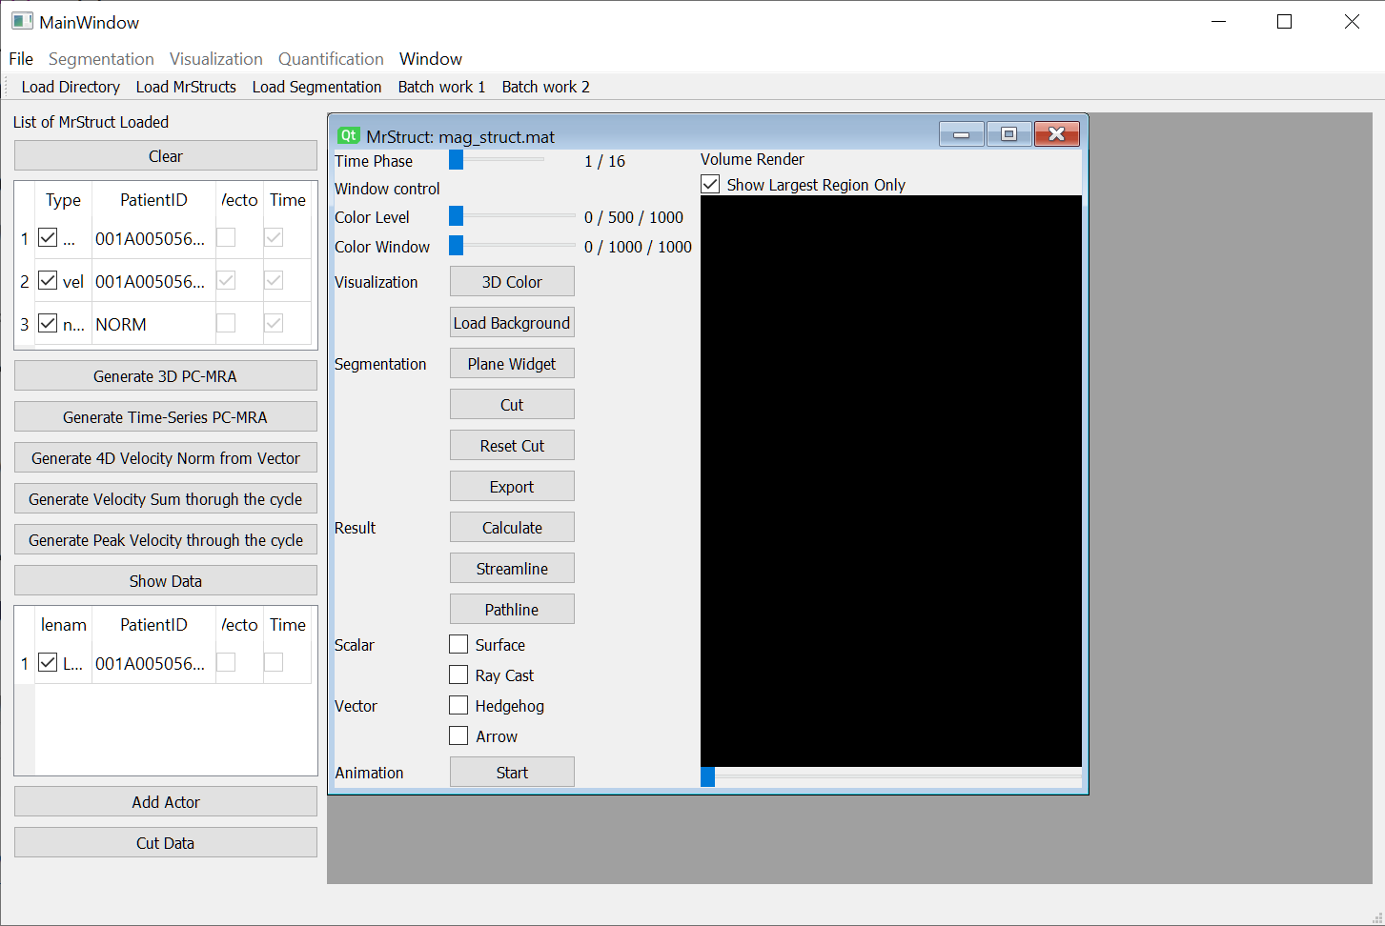
TimeSeriesViewer
Under development version
MDI GUI interface using Qt library
Only GUI skeleton works
I thought that I implemented visualization in view, but it doesn’t work.
Widget_TimeSeriesView.py has already lots of code. It should work with a little effort.
Run Main.py <mrstruct folder path>
<mrstruct folder path>: folder that contains mag_struct.mat, vel_struct.mat, and LA_volume.mat

Slide 10
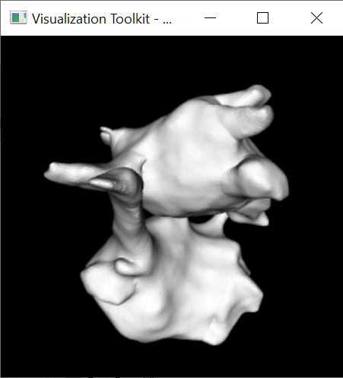
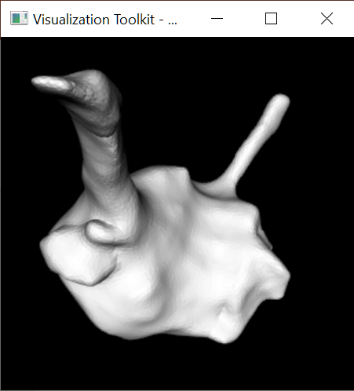
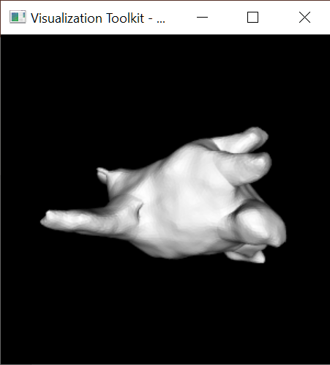
electroMaps
Run showPolygon.py
Visualize Electromaps volumes
Read Electromaps xml file
Visualize whole volume
Visualize each sub volume separately

